Slide 1
JSP - java server pages
JSP is used to develop dynamic web pages and to build dynamic websites.
JSP technology is used to create web application just like Servlet technology.
It can be thought of as an extension to servlet because it provides more functionality than servlet such as expression language, jstl etc.
1

Slide 2
Servlet and JSP
Both servlet & jsp are server side programming language used to generate dynamic web pages.
If we make any changes in our Servlet program, we need to re-compile our servlet program and then again start the server.
But in JSP re-compilation is not required. we just need to click refresh thats it.
In Servlets, Deployment descriptor i.e web.xml is needed.
In JSP there is no need to write the web.xml file.
JSP page provides you with set of implicit objects like request, response, session, out (display data to the client browser) , exception, pageContext, config, , application, page.
These objects are created by JSP Engine automatically during translation phase
In servlet, programmer have to create these objects in service method

Slide 3
Servlet and JSP
In servlet, we write html code inside java code.
In JSP, we write java code inside html code.
JSP gives importance to presentation logic.
Servlet gives importance to bussiness logic.
Servlet support all protocols like HTTP, FTP, SMTP etc.
JSP only support HTTP protocol , only HTTP protocol.
Servlets run faster compared to JSP.
JSPs are first converted into servlets by the JSP container i.e. its a time taking process.

Slide 4
Anatomy of JSP Page
A JSP Page basically consist of two parts:
  HTML code
  JSP tags
There are four types of JSP Tags
  Scriptlet Tag
  Declaration Tag
  Directive Tag
  Expression Tag

Slide 5
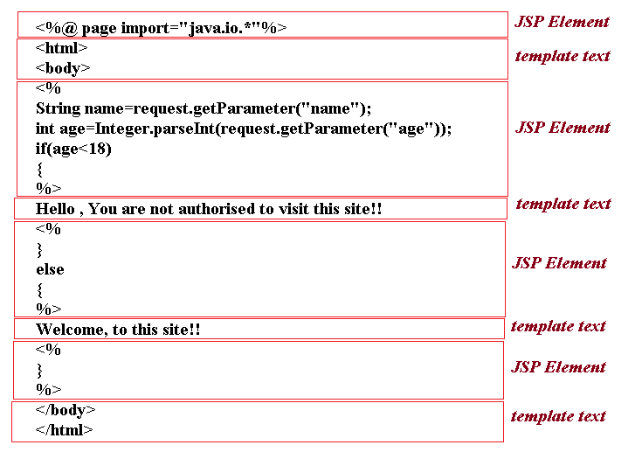
Anatomy of JSP Page

Slide 6
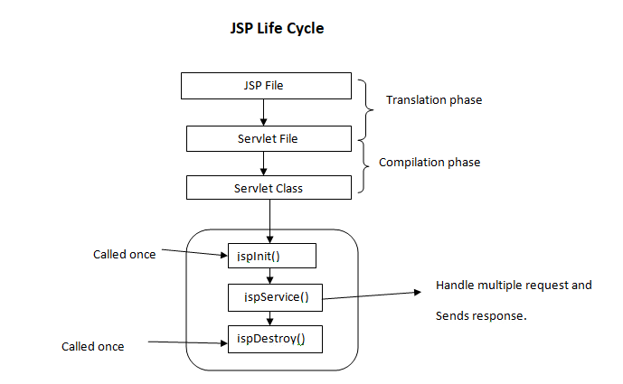
Life Cycle methods
There are three methods which are automatically called when a jsp is requested:

Slide 7
Life Cycle methods
JSP life cycle is grouped into 6 phases:
1.Translation Phase : This is the first step in JSP life cycle.
JSP is converted/Translated into Servlet file by JSP Engine.
2.Compilation Phase: JSP Engine compiles the servlet file into .class file.
3.Instantiation Phase: In this step when the JSP Engine receives the request, class is loaded into memory.
4.Initialization Phase : jspinit() method is invoked by the JSP Engine
public void _jspInit()
{
//initializing the code
}
jspinit() method is called only once during JSP life cycle

Slide 8
Life Cycle methods
5.Servicing : In this phase,_jspservice() method is invoked by the JSP Engine for every request.
void _jspService(HttpServletRequest request HttpServletResponse response)
{
//handling all request and responses
}
6.Destruction: This phse is the end of the JSP life cycle.
In this phase, jspdestroy() method is also invoked by the JSP Engine.
public void _jspDestroy()
{
//all clean up code
}

Slide 9
Scriptlet Tag
Java code is written inside scriptlet Tag.
The statement which is written inside scriptlet tag will be moved to jspservice()
Syntax:
<% java source code %>
Example:
<html>
<body>
<% out.println("welcome to INDIA"); %>
</body>
</html>

Slide 10
Declaration Tag in JSP:
The jsp declaration tag is used to declare one or more variables as well as methods.
When the JSP page is translated into Servlet class:
The code written inside the jsp declaration tag is placed outside the service() method & inside class.
Syntax of JSP declaration tag:
<%! --code-- %>
<html>
<body>
<%!
int count = 0;
%>
Page Count is:
<% out.println(++count); %>
</body>
</html>

Slide 11
Directive Tag in JSP
There are three types of directives:
page directive – most frequently used to import java packages /classes
include directive - It allows us to statistically include JSP/HTML page.
taglib directive - Allows us to use JSTL Java Standard Tag library or custom tag developed by third party.
Page directives:
Attributes of JSP page directive:
import-to import java packages/classes
contentType- to set the response content type sent from server to client.
You remember in servlet we used to write response.setContentType().
<html>
<body>
<%@ page import="java.util.Date" %>
Today is: <%= new Date() %>
</body>
</html>

Slide 12
Expression Tag in JSP
Code inside JSP expression tag is written to the output stream of the response object. i.e we need not have to write out.print().
Syntax of JSP expression tag
<%= JavaExpression %>
Example:
<html>
<head>
<title>JSP expression tag example</title>
</head>
<body>
<%= Hello world inside expression %> <br>
<% out.println("Hello world inside sriptlet with out.println");
Sum of 10 and 20 is =<%= 10+20 %>
</body>
</html>

Slide 13
implicit objects
There are 9 jsp implicit objects.
Implicit Objects and their corresponding classes:
request object is an instance of javax.servlet.http.HttpServletRequest
The main purpose of request object is to get the data entered by user on a JSP page.
response object is instance of javax.servlet.http.HttpServletResponse
response object is used to sent data to the client(browser)
out object is instance of javax.servlet.jsp.JspWriter
This is used for writing content to the client (browser).
In JSP, we don't need to write PrintWriter out=response.getWriter();

Slide 14
implicit objects
session object is instance of javax.servlet.http.HttpSession
Used to store the user’s data to make it available on multiple JSP pages till the user session is active.
exception object is instance of javax.servlet.jsp.JspException
Exception object is used in exception handling for displaying the error messages.
application object is instance of javax.servlet.ServletContext
page object is instance of java.lang.Object
pageContext object is instance of javax.servlet.jsp.PageContext
config object is instance of javax.servlet.ServletConfig

Slide 15
Using Beans in JSP Pages
Java Bean is a JAVA class with the following specification:
class must be declared as public class.
class must implement Serializable interface.
All variable must be declared as private variable, which is also called as bean property.
For every variable, member variable must have methods to set and get the values of properties, known as getter and setter method.
Class should have zero parameterized constructor directly or indirectly

Slide 16
Using Beans in JSP Pages
import java.io.Serializable;
public class Student implements Serializable
{
//bean properties
private int rollno;
private String name;
//Accessor Methods
public int getRollno()
{
return rollno;
}
public void setRollno(int rollno)
{
this.rollno=rollno;
}
public String getName()
{
return name;
}
public void setName(String name)
{
this.name=name;
}
}

Slide 17
Using Beans in JSP Pages
jsp:useBean tag will make above bean available to use in JSP file.
Syntax: <jsp:useBean id="bean_name" class="class_name" scope="session">
</jsp:useBean>
Example:
<jsp:useBean id="bn" class="p1.Student" scope="session">
</jsp:useBean>
jsp:setProperty tag modifies the property values in bean.
Syntax:
<jsp:setProperty name="bean_id" property="property_name" value="property_value">
</jsp:setProperty>
Example:
<jsp:setProperty name="bn" property="rollno" value="12"></jsp:setProperty>
<jsp:setProperty name="bn" property="name" value="ace"></jsp:setProperty>

Slide 18
Using Beans in JSP Pages
jsp:getProperty tag accesses the property values of bean.
Syntax:
<jsp:getProperty name="bean_id" property="property_name"></jsp:getProperty>
Example:
<jsp:getProperty name="bn" property="rollno"></jsp:getProperty>
<jsp:getProperty name="bn" property="name" ></jsp:getProperty>

